Slide 1




PIZZA SALES ANALYSIS

Slide 2



Project Objective
To develop a comprehensive Pizza Sales Analysis dashboard that provides real-time insights into key performance metrics and trends, enabling stakeholders to monitor and analyze sales effectively.

Slide 3
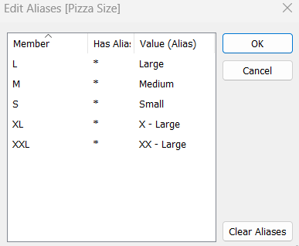

TABLEAU
DATA
PROCESSING

Slide 4
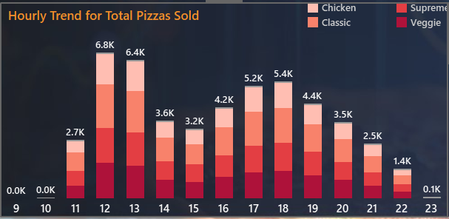

TABLEAU
DATA
VISUALIZATION

Slide 5
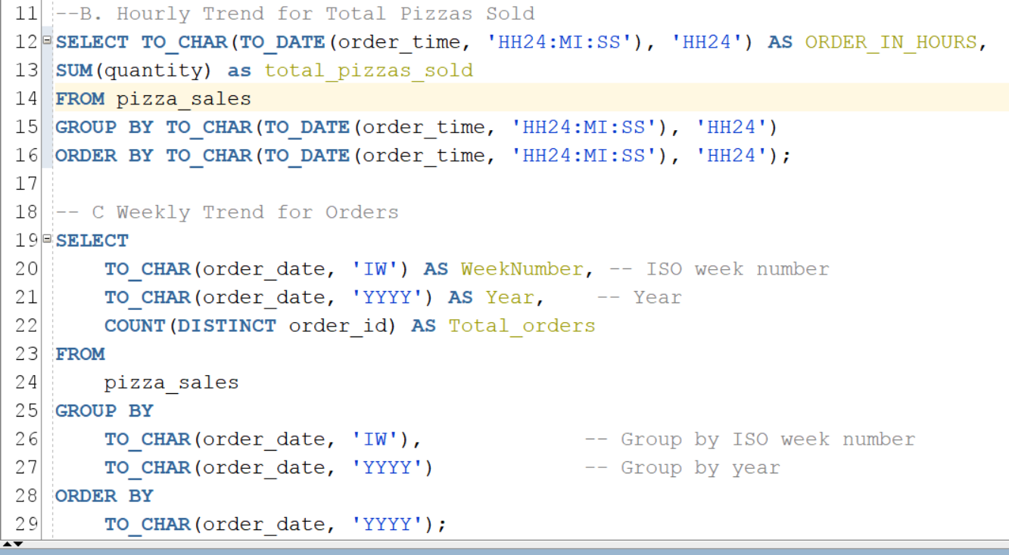
WRITING
QUERIES

Slide 6
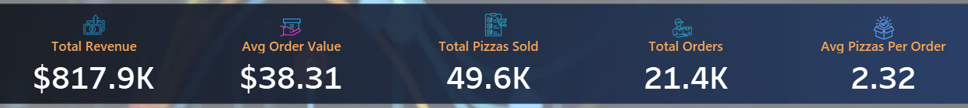
KPI’s REQUIREMENT
We need to analyze key indicators for our pizza sales data to gain insights into our business performance. Specifically, we want to calculate the following metrics:
Total Revenue: The sum of the total price of all pizza orders.
Average Order Value: The average amount spent per order, calculated by dividing the total revenue by the total number of orders.
Total Pizzas Sold: The sum of the quantities of all pizzas sold.
Total Orders: The total number of orders placed.
Average Pizzas Per Order: The average number of pizzas sold per order, calculated by dividing the total number of pizzas sold by the total number of orders.

Slide 7
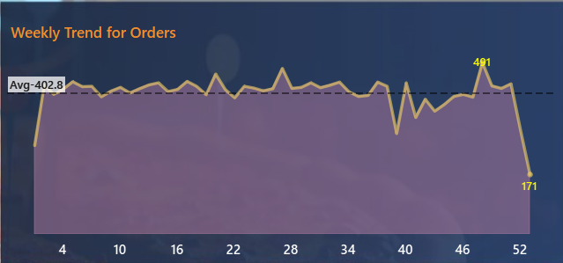
ANALYSIS OUTCOMES
HOURS
Peak orders are between 12:00 PM and 1:00 PM, and in evening from 4:00 PM to 7:00 pm.
WEEKS
Significant variations in weekly orders, with highest peak during the 48th week from the month of Dec.

Slide 8
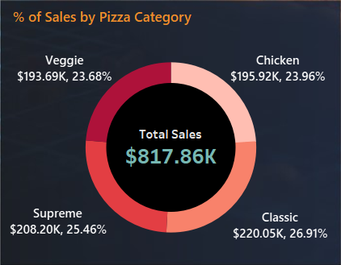
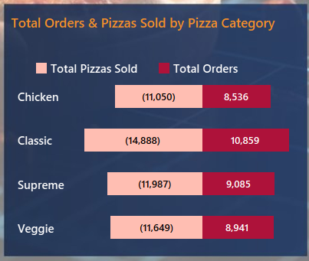
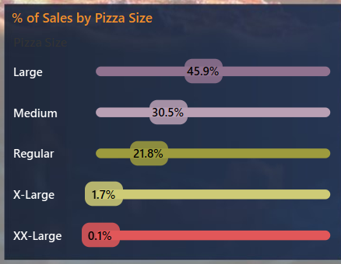
ANALYSIS OUTCOMES
CATEGORY
Classic category contributes to maximum sales, Total Orders & Total Pizzas Sold.
SIZE
Large Pizza Size contributes to maximum Total Sales.

Slide 9
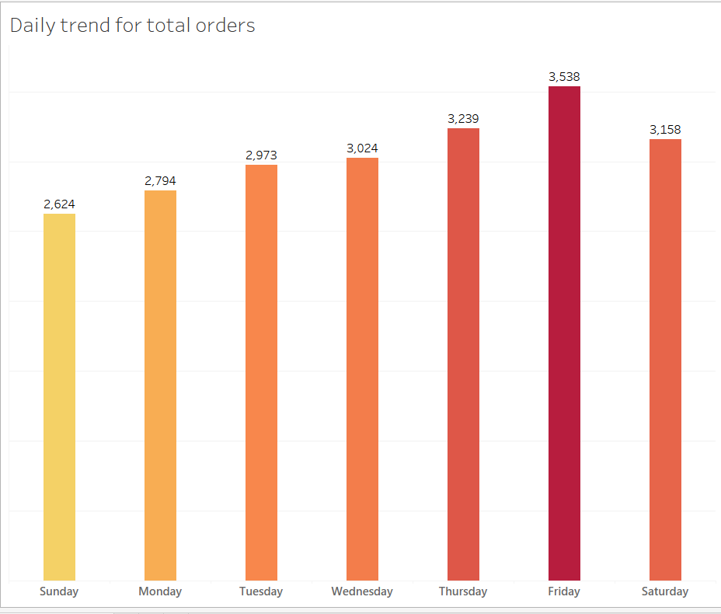
ANALYSIS OUTCOMES
DAYS
Orders are highest on weekends Friday(3,538)
Thursday(3,239)
REVENUE
The Thai Chicken Pizza contributes To Maximum revenue
QUANTITY
The Classic Deluxe Pizza contributes to Maximum Total Quantities
TOTAL ORDERS
The Classic Deluxe Pizza contributes to Maximum Total Orders

Slide 10
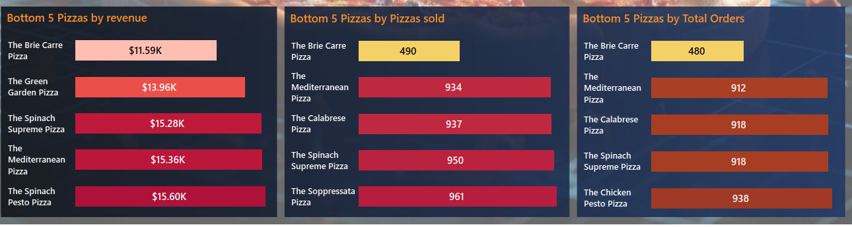
LEAST PERFORMANCE
REVENUE
The Bire Carre Pizza contributes To Minimum revenue
QUANTITY
The Bire Carre Pizza contributes to Minimum Total Quantities
TOTAL ORDERS
The Bire Carre Pizza contributes to Minimum Total Orders

Slide 11

INSIGHTS AND RECOMMENDATIONS
Following the analysis most of orders are between 12:00 PM and 1:00 PM, and in evening from 4:00 PM to 7:00 pm. Offer more discounts and maintain adequate number of pizzas to generate more revenue.
Classic (26.91%),Supreme(25.46%) category pizza are most ordered and large size(45.91%) pizza contributes maximum sales so it can generate more revenue during Fridays and Saturdays.
Actual Revenue mostly comes from Thai Chicken Pizza.($43.4K).
Bire Carre pizza is the least ordered and it generate less revenue
($11.59K).

Slide 12
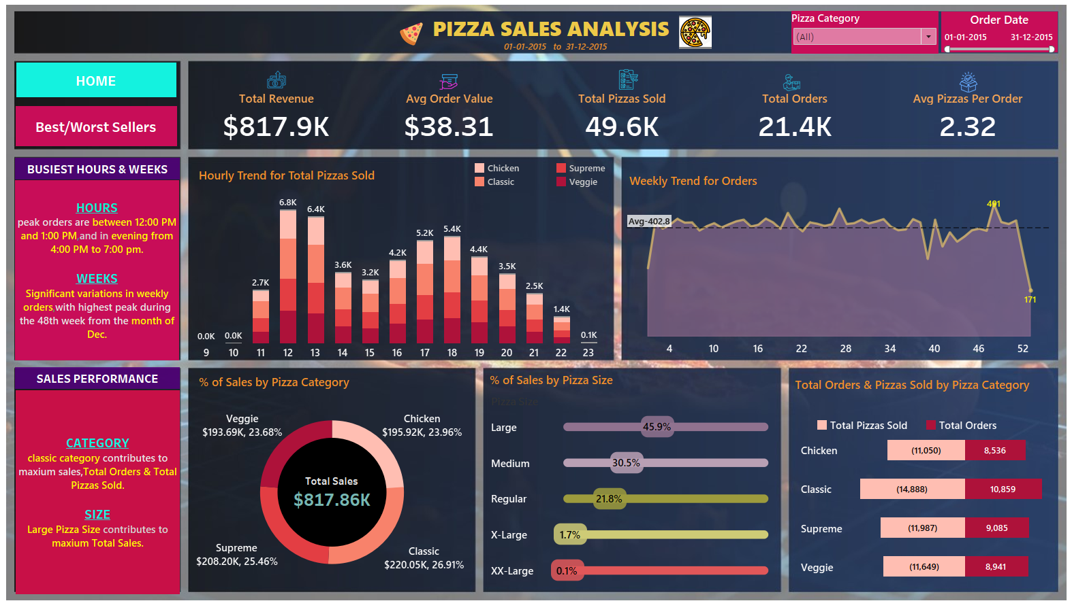
TABLEAU
REPORT/ DASHBOARD

Slide 13
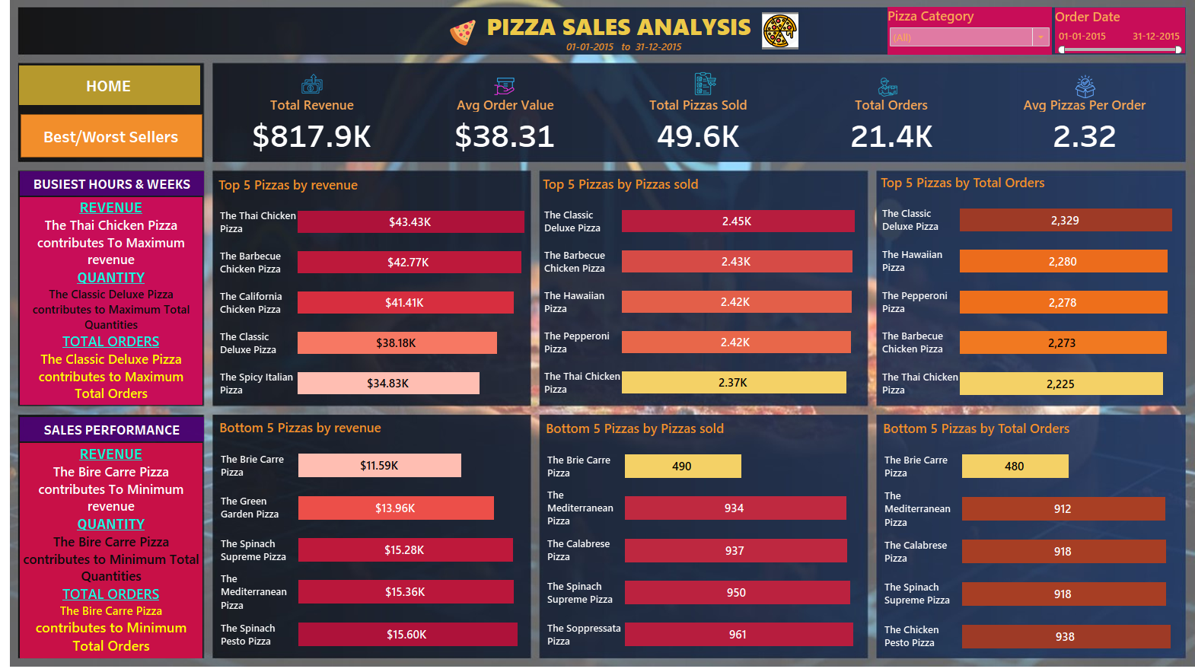
TABLEAU
REPORT/ DASHBOARD

Slide 14

Download Data
GitHub:
https://github.com/ivamcthor/Pizza_sales_analysis
PROJECT BY
SAI VAMSIDHAR ITHA

